Slide 1
CW
PORTFOLIO
Won Chulhee
Full-stack Developer
FLUTTER | ANDROID | PWA | CLAUDE CODE
2026.01

Slide 2
01
ABOUT ME
CORE SKILLS
CW
Won Chulhee
Full-stack Developer
Flutter/Dart
Android Native
Claude Code와 MCP를 기반으로 기획, 디자인, 프론트, 백엔드 개발까지 풀스택으로 폭넓게 개발하고 있습니다.
Cross-platform
Java/Kotlin
Flash(AS3), Android Native(Java/Kotlin), Flutter(Dart)를 기반으로 다양한 플랫폼에서 개발 경험을 쌓았습니다.
Claude Code
PWA
AI Development
Web/App
buelmanager@gmail.com
Seoul, South Korea
Kiosk
Firebase
Interactive
Backend

Slide 3
02
EXPERIENCE
2025.8 - Now
Freelancer - Full-stack Developer
Claude Code & MCP & Firebase Full-stack / Android/iOS Mobile, PWA / Kiosk
Claude & MCP
Flutter
Android
2016.9 - 2025.8
Woongjin ThinkBig - Mobile Developer
Education Mobile App / Flash to Flutter Migration / Android Native Maintenance
Flutter
Android
Kotlin
2010.1 - 2016.9
Freelancer - Flash Developer
Education Content / Kiosk System / Interactive Media
Flash
ActionScript
2008.1 - 2010.1
NOS Corp - Flash Developer
Education Content Development

Slide 4
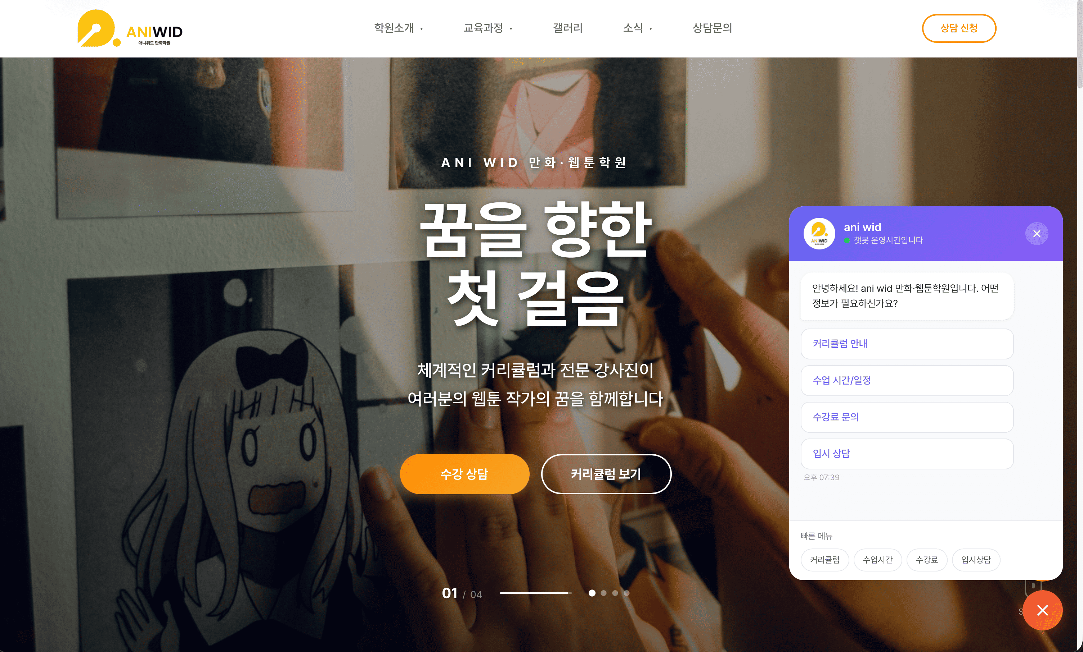
03 — PROJECT
Academy Homepage + Admin Chatbot
PWA
2026.1 / 5 Days
Claude Code로 기획/디자인부터 Full-stack 개발. React/Firebase 기반 반응형 홈페이지 20페이지 + 어드민 15페이지 + 룰셋 기반 챗봇 구현
KEY FEATURES
• 반응형 웹사이트 20+ 페이지
• 어드민 대시보드 15+ 페이지
• 룰셋 기반 AI 챗봇
• 모든 모듈 어드민 수정 가능
TECH STACK
React
TypeScript
Firebase
Firestore
Vite

Slide 5
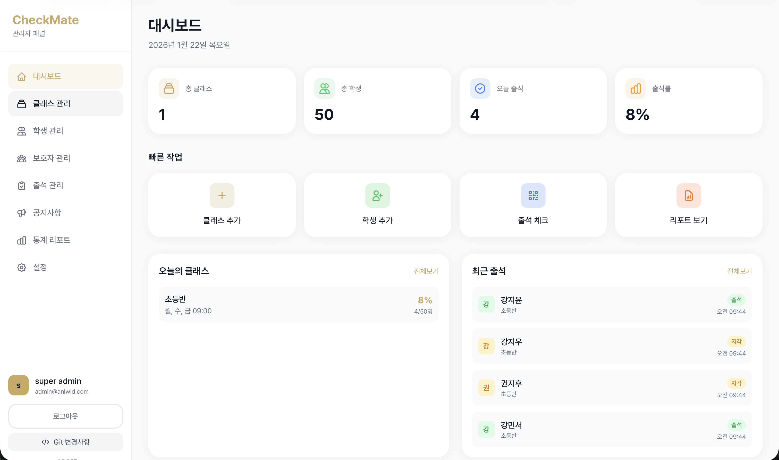
04 — PROJECT
Student Management PWA
PWA
2026.1 / 5 Days
Claude Code 기획/디자인 Full-stack 개발. 학원 원생관리 시스템 - QR Code 출석체크, 부모님 Push 알림 기능
KEY FEATURES
• 전체 원생 관리 대시보드
• QR Code 출석 체크 시스템
• FCM Push 부모 알림
• PWA 반응형 Web/App
TECH STACK
React
TypeScript
Firebase
FCM
QR Code

Slide 6
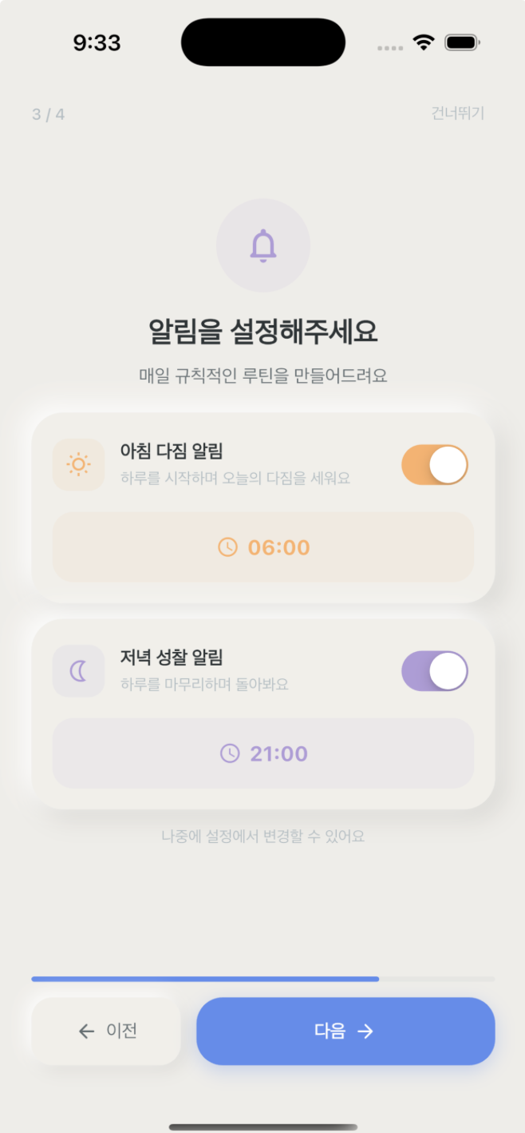
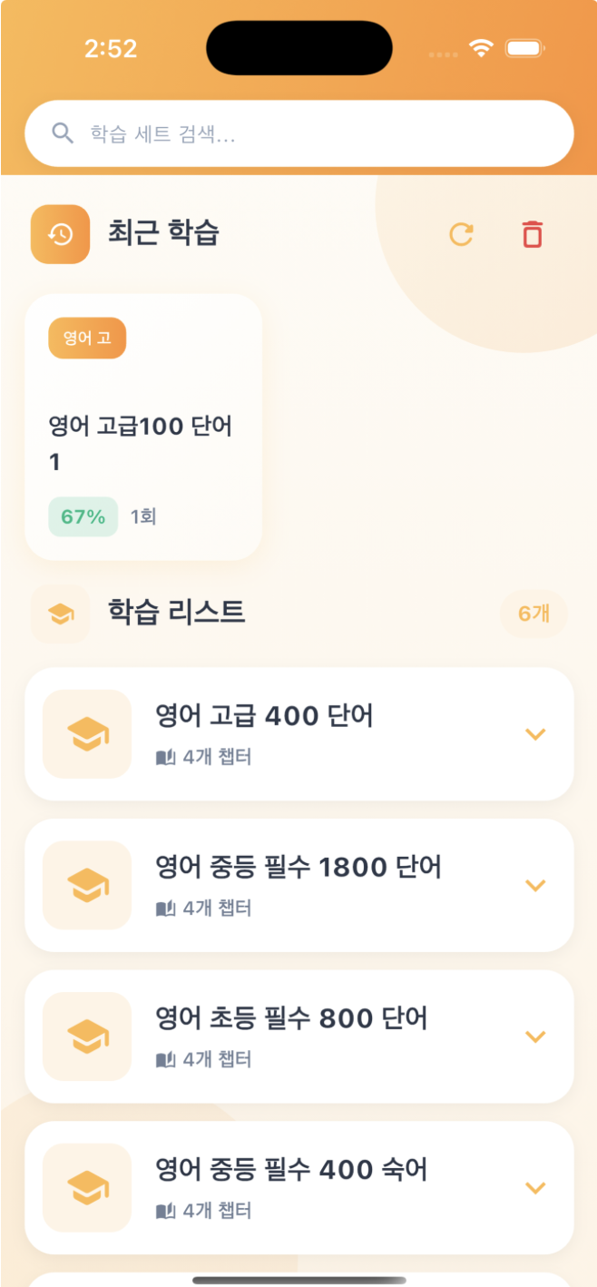
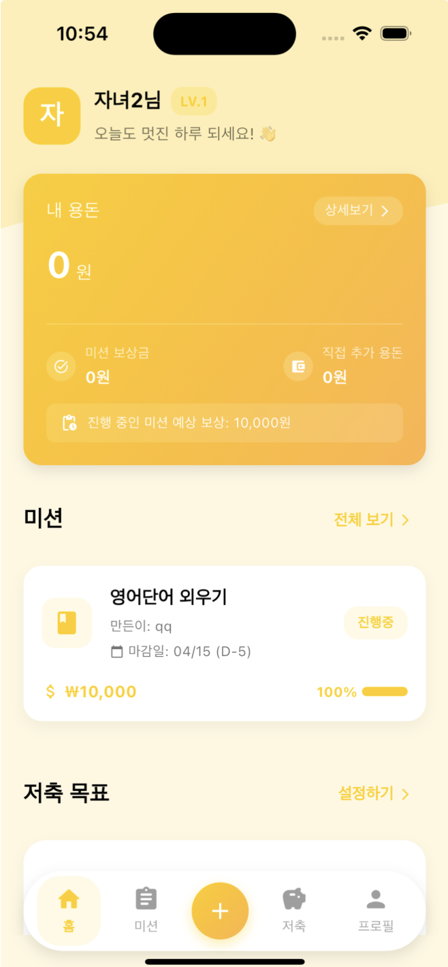
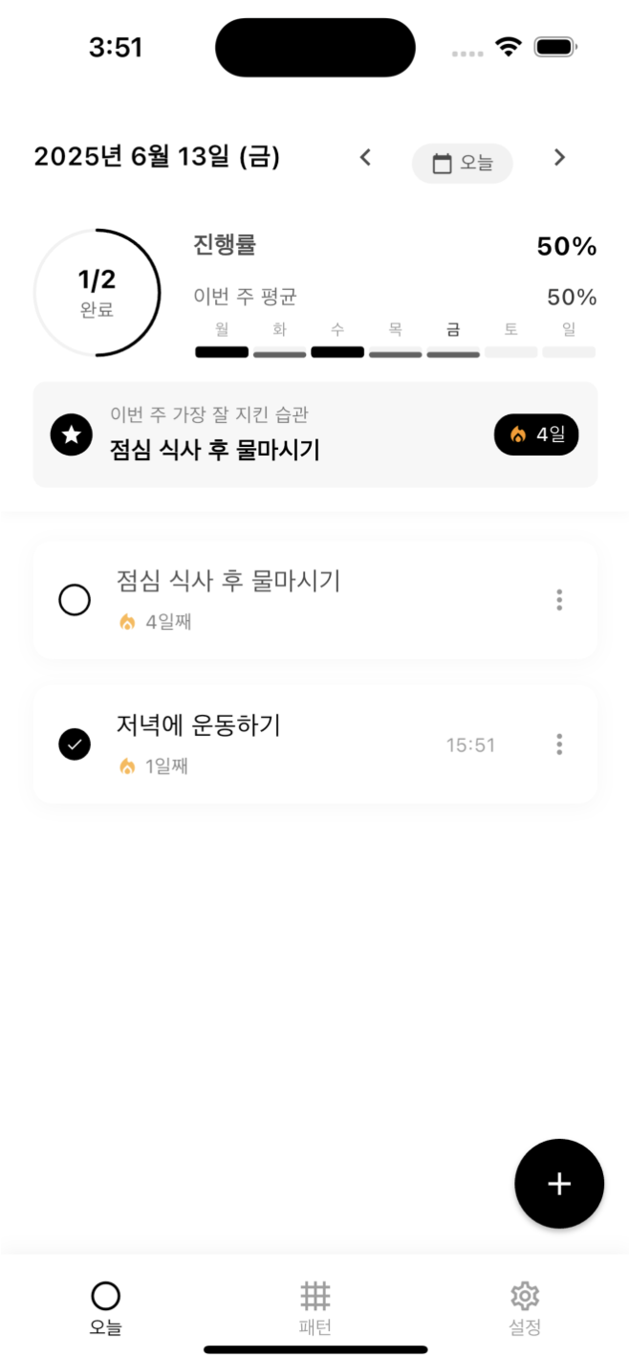
05 — PROJECT
Flutter Mobile Apps (iOS/Android)
Franklin Flow
Mango Vocabulary
Ferret
Dot Todo
Self Management
Word Learning
Allowance Manager
Task Manager
자기관리앱, MVVM Pattern
단어암기, Firebase 연동
용돈관리, 가족일정
할일관리, FCM Push
All apps built with Claude Code / Flutter / Firebase / MVVM Pattern / Clean Architecture

Slide 7
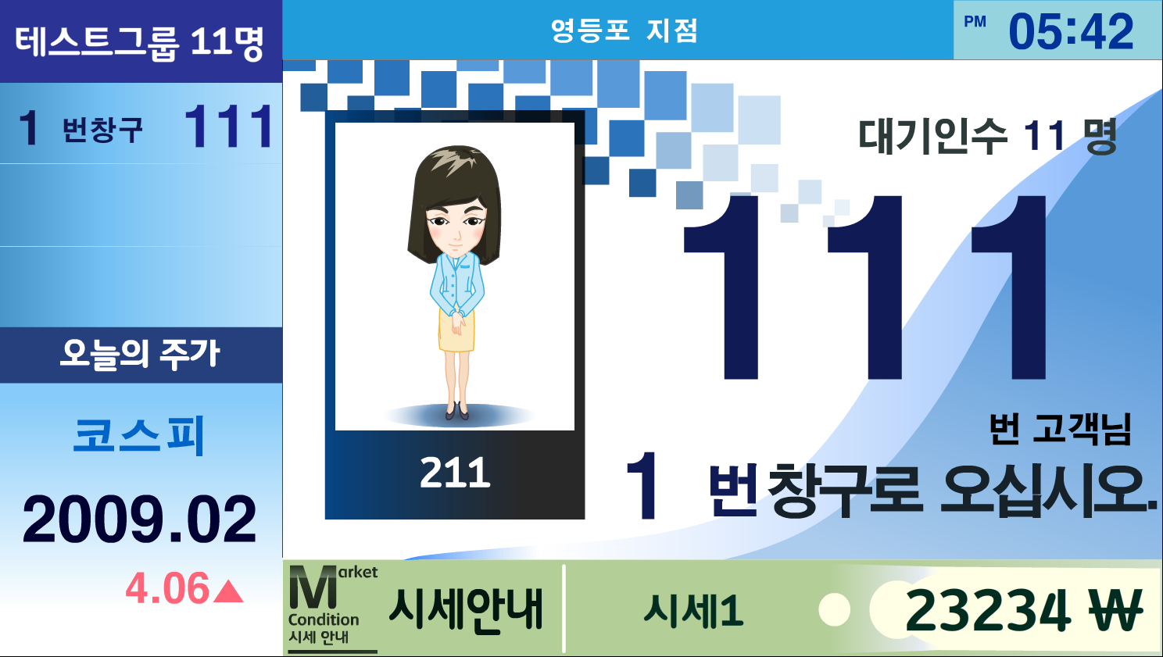

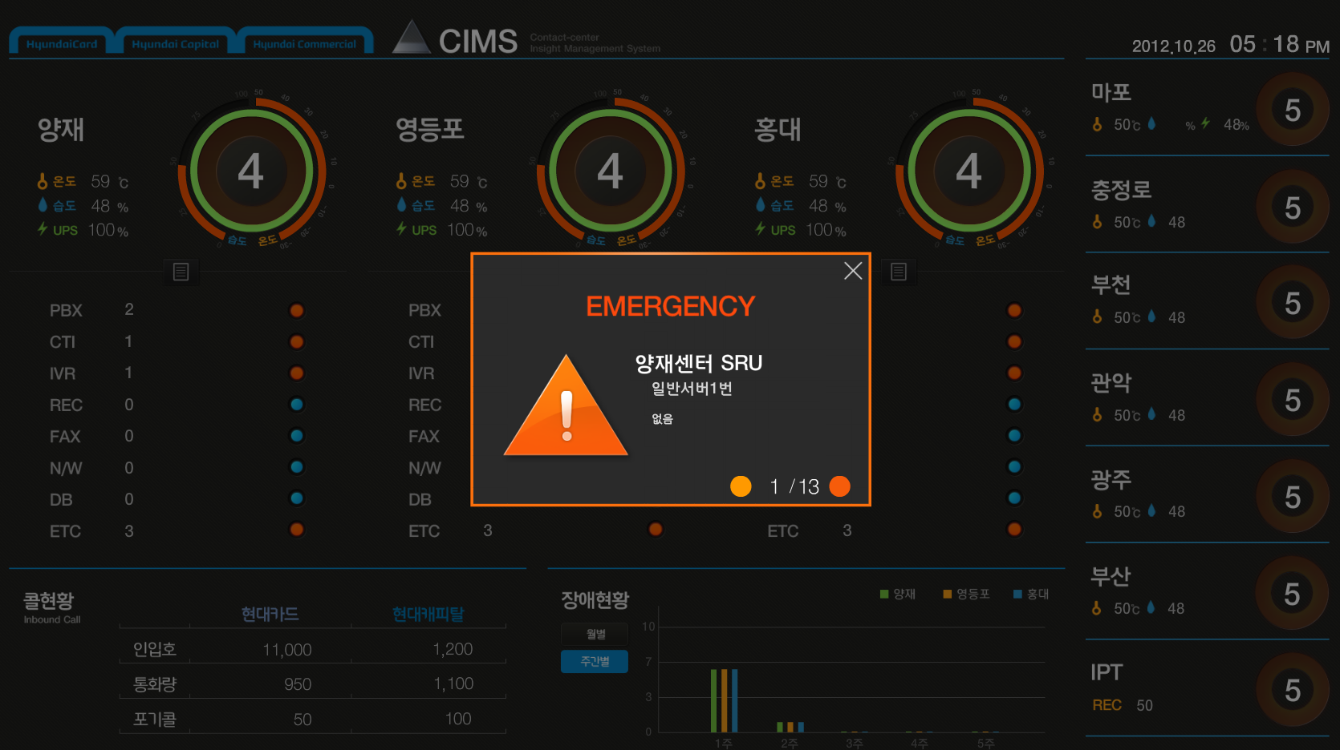
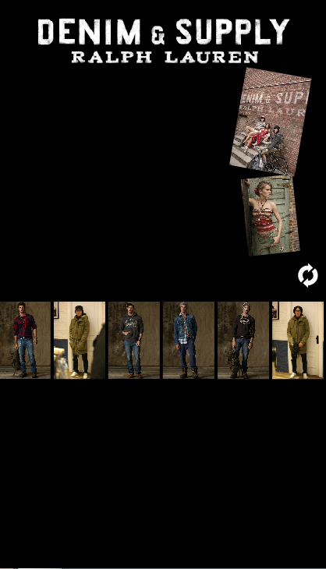
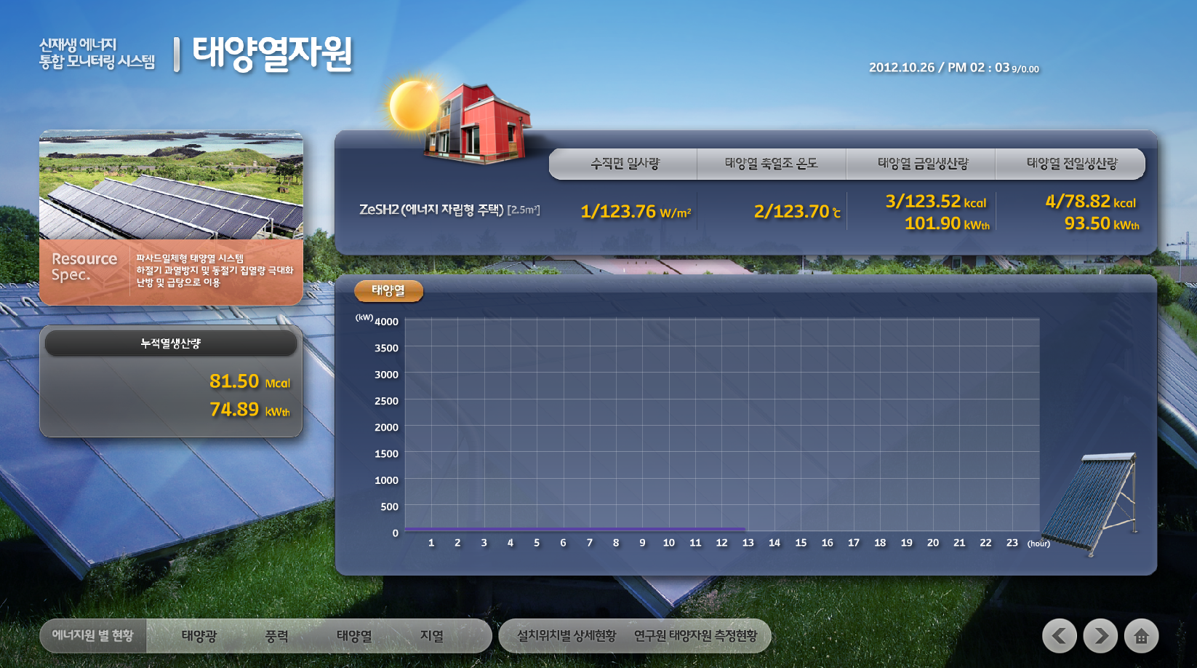
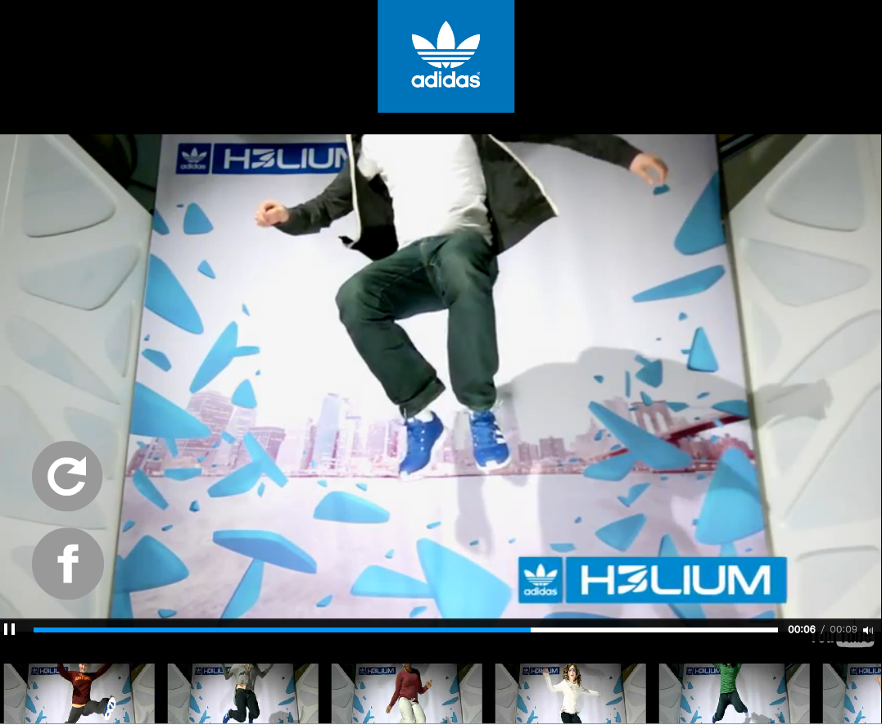
06 — PROJECT
Kiosk Systems
Woori Bank
KEB Hana Bank
Hyundai CIMS
Banking Kiosk
Banking Kiosk
Contact Center
2012
2013
2013
Ralph Lauren
Renewable Energy
Adidas / Hanwha
Promotion Kiosk
Monitoring System
Promotion Kiosk
2013
2013
2010

Slide 8
THANK YOU
Let's Work Together
@
GH
KR
EMAIL
GITHUB
LOCATION
buelmanager@gmail.com
github.com
Seoul, South Korea
CW
Won Chulhee
Full-stack Developer
© 2025 Won Chulhee. All Rights Reserved.

